Slide 1


[DATA ANALYSIS]

Slide 2


Today's agenda
Project recap
Problem
The Analytics team
Process
Insights
Summary

Slide 3

social buss is fast growing techonology unicorn that need adapt quickly to its global scale.
Accenture has begun 3 month poc focusing on these three tasks
1. an adult of social buss is big data practice
2. Recommendation for scccesful ipo
3. analysis to find social buzz s top 5 most popular categories of content
Project Recap

Slide 4


Over 100000 posts per day
36,500,000 pieces of content per year
But how to capitlaize on it when there is so much
Analysis to find social buzz’s top5 most popular
Categories of content
Problem

Slide 5



The Analytics team

Slide 6
Process
1 Data understaning
2 Data cleaning
3 Data modelling
4
5 Uncoverd insight

Slide 7

Insights
16 1897 January
Unique reaction animal month with
Categoris posts most post

Slide 8
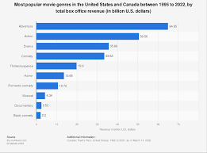

Slide 9
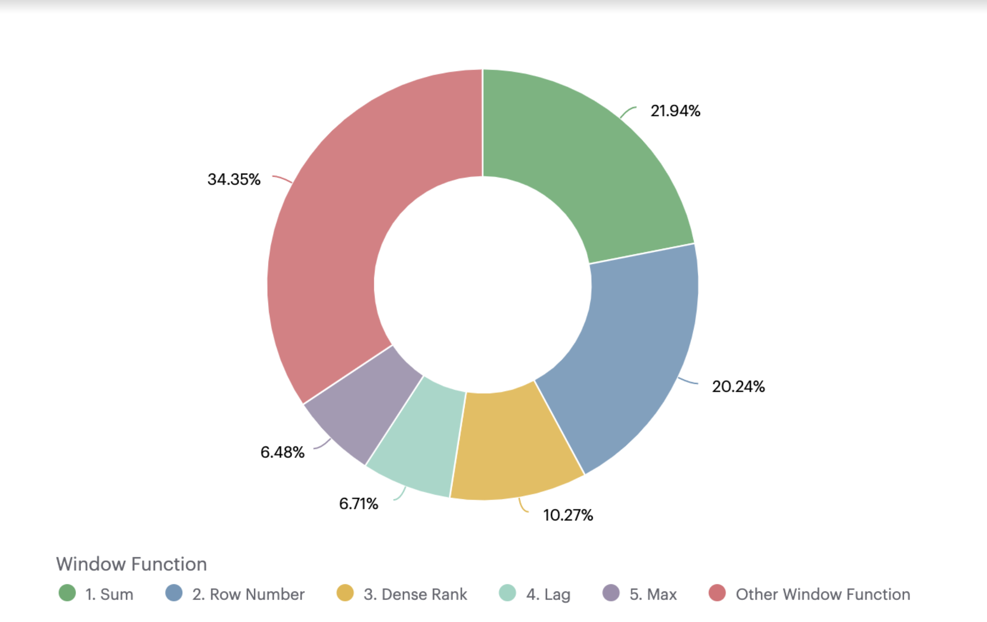

Slide 10

ANALYSIS Animals and science are the two most popular categories of content, showing that people enjoy "real-life" and "factual" content the most.
INSIGHT Food is a common theme with the top 5 categories with "Healthy Eating" ranking the highest. This may give an indication to the audience within your user base. You could use this insight to create a campaign and work with healthy eating brands to boost user engagement.
NEXT STEPSThis ad-hoc analysis is insightful, but it's time to take this analysis into large scale production for real-time understanding of your business. We can show ou how to do this,
Summary

Slide 11

Thank you!
ANY QUESTIONS?

